Slide 1
Development of prospective teachers’ metacognitive skills while performing, designing and implementing mathematical problems using Scratch
Nimer Baya'a Juhaina Shahbary Wajeeh Daher Otman Jaber
Al-Qasemi Academic College of Education, Baqa-El-Gharbia, Israel
The 7th International Conference on Teacher Education: The Story of Innovation in Teacher Education June 24 – 26, 2019 MOFET Institute, Tel Aviv, Israel

Slide 2
Introduction
Metacognitive skills are considered critical in solving mathematical problems.
Several researchers are examining the use of Scratch, as a visual programming language, in developing mathematical concepts.
In the current study, we examined the development of metacognitive skills of prospective teachers while performing, designing and implementing mathematical problems using Scratch.

Slide 3
Introduction
We examined this development at three levels: in their solving of mathematical problems, in their designing mathematical problems for their students and in their implementing these problems in the mathematics classroom.

Slide 4
Research questions
How would the prospective teachers’ metacognitive skills develop while engaged with metacognitive-based mathematical problem solving using programming in Scratch?
How the changes in metacognitive skills will be reflected in prospective teachers’ design of mathematical problems?
How the changes in metacognitive skills will be reflected in prospective teachers’ implementation of mathematical problems?

Slide 5
Research participants
Eighteen pre-service teachers participated in the preparation.
They were in their third academic year majoring in teaching mathematics and computer science in middle schools.
The preparation of the prospective teachers was held for a full academic year.
Along this academic year, the prospective teachers worked in groups of 4 members.

Slide 6
Research Procedure
The preparation of the prospective teachers went through the following stages:
Stage one: Solving mathematical problems using metacognitive skills and Scratch.
Stage two: Designing mathematical problems that would encourage pupils’ metacognitive skills using Scratch
Stage three: Implementing the mathematical problems, that they designed, in the mathematics classroom
Reflection in each stage.

Slide 7
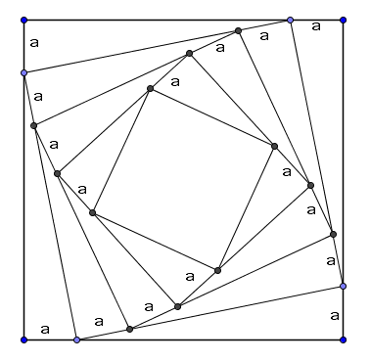
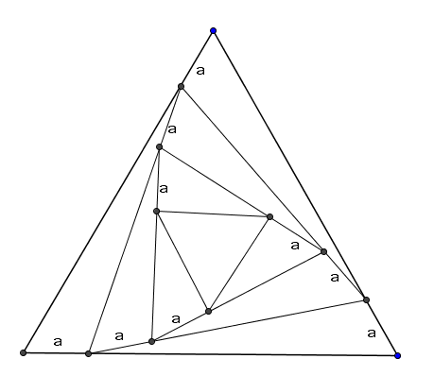
Research Procedure
In the first stage, the 4 groups of the prospective teachers were engaged in solving a sequence of mathematical problems that require the utilization of Scratch for graphical and programing purposes through utilizing metacognitive skills.

Slide 8
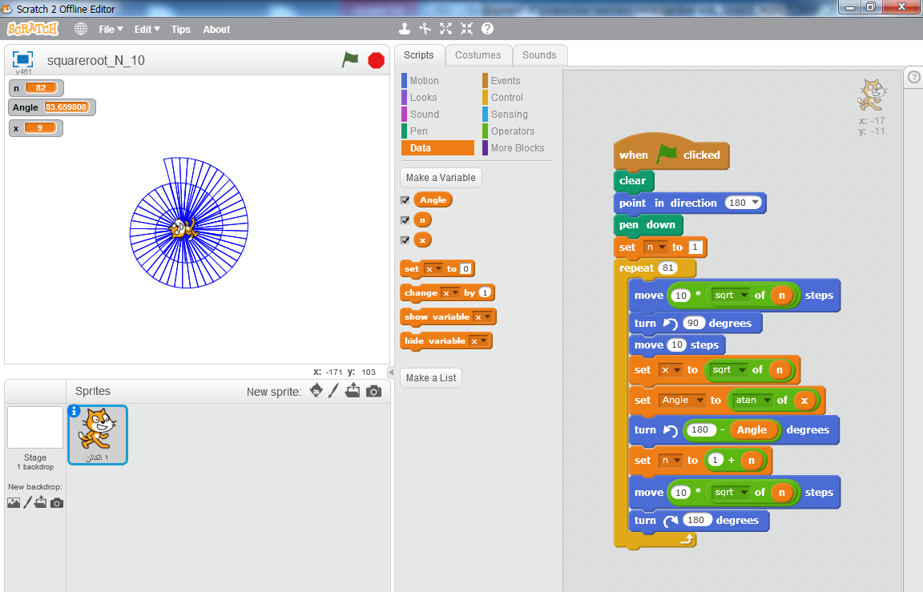
Research Procedure

Slide 9
Research Procedure
In the second stage, the 4 groups of the prospective teachers were engaged in designing a sequence of mathematical problems that require the utilization of Scratch for graphical and programing purposes through utilizing metacognitive skills.
Example: Activities in the subject of Natural Numbers

Slide 10
Research Procedure

Slide 11
Data collection
The study was conducted along one year, during which the collection of data occurred in several stations due to long and complicated procedures of gathering and analyzing data.

Slide 12
Data collection
The data sources included video recording of the groups while they perform mathematical problems, design and implement the problems in classroom.
Another source of data was interviews with the participating prospective teachers, where the target of the interviews is to examine the development of the metacognitive skills through the three stages.

Slide 13
Data analysis
The analysis of the different types of data will be based on Wilson and Clark (2004) framework of identifying metacognitive skills that include three components: awareness, assessment and regulation.

Slide 14
Initial Results
Our initial findings indicate that the participating prospective teachers developed their metacognitive skills in the first two levels; as problem solvers and as designers of mathematical problems.

Slide 15
Questions for discussion
What are the features of the theoretical model that describes the development of metacognitive skills of mathematics prospective teachers who work through three stages: problem solving, designing mathematical problems and implementing mathematical problems using Scratch?

Slide 16
References
Daher, W., Baya'a, N., Jaber, O., & Anabousy, A. (2018). Preparation phases for developing pre-service mathematics teachers' metacognitive thinking skills in learning and teaching. Paper presented at the International Conference on Education in Mathematics, Science & Technology (ICEMST), April 28-May 1, 2018. Marmaris, Turkey.
ScratchMaths: https://www.ucl.ac.uk/ioe/research/projects/scratchmaths

Slide 17
References
Duangnamol, T., Supnithi, T., Srijuntongsiri, G., & Ikeda, M. (2018). Computer-Supported Meta-reflective Learning Model via mathematical word problem learning for training metacognition. Research and Practice in Technology Enhanced Learning, 13(1), 14.
Flavell, J. (1976). Metacognitive aspects of problem solving. In L. Resnick, (Ed.), The nature of intelligence (pp. 231-235). Hillsdale, NJ: Erlbaum.
Schneider, W., & Artelt, C. (2010). Metacognition and mathematics education. ZDM - The International Journal on Mathematics Education, 42(2), 149–161.
Wilson, J. (2001). Assessing metacognition. Unpublished doctoral thesis, The University of Melbourne.
Wilson, J., & Clarke, D. (2004). Towards the modelling of mathematical metacognition. Mathematics Education Research Journal, 16(2), 25-48.

Slide 18
Appendix - Data analysis
Metacognitive awareness
Relates to individuals’ awareness of where they are in the learning process or in the process of solving a problem.
Includes their knowledge of what needs to be done, what has been done, and what might be done in particular learning contexts or problem solving situations.

Slide 19
Appendix - Data analysis
Metacognitive action card statements for awareness:
I thought about what I already know
I tried to remember if I had ever done a problem like this before
I thought about something I had done another time that had been helpful
I thought ‘I know what to do’
I thought ‘I know this sort of problem’

Slide 20
Appendix - Data analysis
Metacognitive evaluation
Refers to judgements made regarding one’s thinking processes, capacities and limitations as these are employed in a particular situation or as self-attributes.

Slide 21
Appendix - Data analysis
Metacognitive action card statements for evaluation:
I thought about how I was going
I thought about whether what I was doing was working
I checked my work
I thought ‘Is this right?’
I thought ‘I can’t do it’

Slide 22
Appendix - Data analysis
Metacognitive regulation
Occurs when individuals make use of their metacognitive skills to direct their knowledge and thinking.
Metacognitive regulation draws upon individuals’ knowledge (about self and strategies, including how and why they use particular strategies) and uses executive skills (such as planning, self-correcting, setting goals) to optimize the use of their own cognitive resources.

Slide 23
Appendix - Data analysis
Metacognitive action card statements for regulation:
I made a plan to work it out
I thought about a different way to solve the problem
I thought about what I would do next
I changed the way I was working

Slide 24
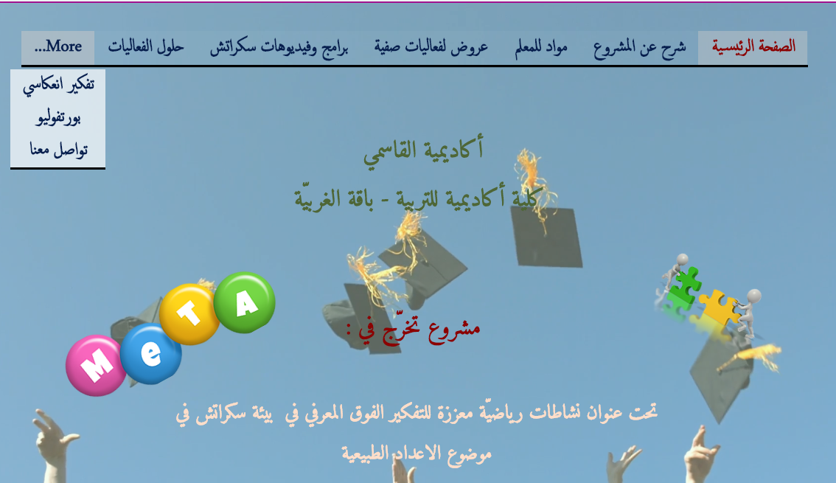
Appendix – Example of design
Natural Numbers
https://maha2923.wixsite.com/grpro-naturalnumber

Slide 25
Thanks for your attention
Nimer Baya'a Juhaina Shahbary Wajeeh Daher Otman Jaber
Al-Qasemi Academic College of Education
End

