Slide 1
The Development of Pre-Service Teachers’ TPACK in the Use of Digital Tools TWG 15 – Teaching Mathematics with Technology and other Resources
Nimer Baya'a, Wajeeh Daher, Rawan Anabousy and Ahlam Anabousy
Al-Qasemi Academic College of Education, Israel, bayaan@qsm.ac.il An-Najah National University, Palestine
CERME - 10th Congress of European Research in Mathematical Education 1-5 February, 2017 Dublin, Ireland

Slide 2
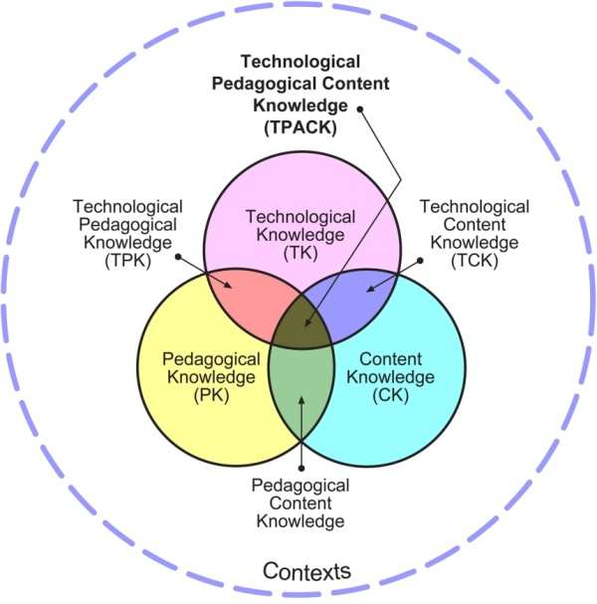
Introduction
The TPACK Model as in Koehler and Mishra (2009)

Slide 3
Introduction
Some researchers consider TPACK too blunt an instrument (e.g., Clark-Wilson & Hoyles, 2016; Thomas & Palmer, 2014).
Other researchers refer to it when studying mathematics teacher’s professional development (e.g., Balgalmis, Shafer, & Cakiroglu, 2013; Bowers & Stephens, 2011).

Slide 4
Introduction
Robova, and Vondrova (2015) studied mathematics teachers’ awareness of the specific technological skills needed for their teaching (making functions visible on the screen, changing visual appearance of graphs, interpreting numerical results, using dynamic features of a tool) and their ability to design teaching which takes the specific skills into account

Slide 5
Introduction
Furthermore, Koh and Divaharan (2011) described an instructional model for developing pre-service teachers’ TPACK.
We follow the previous attempts to suggest a preparation model for developing pre-service teachers’ TPACK in utilizing digital tools in their teaching.

Slide 6
Introduction
Researchers found that attitudes have major influence on the success and meaningful use of the ICT in their teaching (Albirini, 2006).
In our research, attention was given to pre-service teachers' attitudes toward computers, together with the development of their TPACK and ICT proficiency, as a consequence of their preparation in the use of digital tools.

Slide 7
Introduction
We used teacher's attitudes toward computers' questionnaire (TAC) for it implies teachers' attitudes toward ICT use in teaching and their intention to do so (Baya'a & Daher, 2013).

Slide 8
Introduction
We were also interested in pre-service teachers' proficiency level in ICT as an indicator of their intention to use ICT in their teaching as the proficiency variable is reported to affect teachers' readiness to use ICT in their teaching (Granger, Morbey, Owston & Wideman, 2002).

Slide 9
The Research Question
How the preparation of pre-service teachers in the use of digital tools, according to the model that we designed, will affect their TPACK level, ICT proficiency and their attitudes toward computers?

Slide 10
Research Context
The current research accompanies the preparation of pre-service teachers to study how to use effectively digital tools in the mathematics or science classroom.
We administered questionnaires to measure the advancement of the TPACK levels and attitudes toward computers of the pre-service teachers who implemented the model, as well as their ICT proficiency.

Slide 11
Research Participants
Approximately 55 students majoring in mathematics and science teaching in intermediate schools completed the questionnaires at the beginning and end of the preparation.

Slide 12
The Preparation Model
The preparation model aimed to improve the pre-service teachers' selection of proper digital tool for a specific pedagogy and subject. It also tried to improve the integration of digital tools in teaching a specific content.
First, knowing the tool technically and being able to adjust it for teaching a specific content. Second, developing the ability to select and integrate proper digital tools for a specific content and pedagogical method.

Slide 13
The Preparation Model
TPACK
Technology
Pedagogy
Content
Digital Tools
Pedagogy
Math Content

Slide 14
The Preparation Model
Preparation Phases
I
II
III
IV
V
From Technology to Content
From Content to Technology
Implement
Reflect
Post

Slide 15
The Preparation Model
Phase I
Learn 2 D.T. Technically
Prepare User Guide (PDF File or Digital Book)
Record Video Clips of Screen Capture
Example of How to Use D.T. in Teaching
Present in Training Workshop, Reflect & Adjust
Constructing Internet Site for all Developed Materials Including Data Bank of D.T.
Catalog of Digital Tools Ministry of Ed.
Flipsnack
Linoit
Socrative
Mindomo
…….

Slide 16
The Preparation Model
Phase II
Prepare 2 Lessons for Teaching a Specific Content
Pick 3 D.T. from Data Bank of D.T. Including One that was Engaged with
Include Collaborative Investigation and Encourage HOTS
Pick Subject in Digital Textbook
Add Layers and Links to Pedagogical Activities Based on D.T.

Slide 17
The Preparation Model
Phases III, IV, V
III - Implement
IV - Reflect
V - Post
Experiment with the Prepared Materials and Lessons in Training School
Reflect on Experimenting with at Least One of the D.T. that was Engaged with
Post Reflections in the Data Bank of D.T.

Slide 18
Research instruments
First questionnaire: Technological, Pedagogical, and Content Knowledge (TPACK) – revised questionnaire. The current questionnaire was constructed on the basis of the TPACK instrument for pre-service teachers developed by Schmidt et al. (2009).

Slide 19
Research instruments
Second questionnaire: Teachers' Attitudes toward Computers (TAC, v. 6.1) questionnaire: This questionnaire was tested by Christensen and Knezek (2009) who concluded that it is a well-validated and reliable instrument for teachers' self-appraisal of their attitudes toward computers.

Slide 20
Research instruments
Third questionnaire: The Use of ICT in Colleges of Education (UICT): This questionnaire was developed by The MOFET Institute to follow the professional development of pre-service teachers in ICT use. The ICT proficiency part of the questionnaire was used in the present research.

Slide 21
Results
Pre-service teachers' ICT proficiency
Table 1 shows the proficiency level of the pre-service teachers before and after the preparation (values between 1 to 5), as well as paired sample t-test between the two observations.
Table 1: Means, standard deviations and t-test for pre-service teachers' ICT proficiency (n=54)

Slide 22
Results

Slide 23
Results
Pre-service teachers' TPACK level
Table 2 shows the TPACK components' scores of the pre-service teachers before and after the preparation (values between 1 to 5), as well as paired sample t-test between the two observations.
Table 2: Means, standard deviations and t-test for pre-service teachers' TPACK level (n=54)

Slide 24
Results
Pre-service teachers' attitudes toward computers
Table 3 shows components' scores of the pre-service teachers' attitudes toward computers before and after the preparation (values between 1 to 5, except perception 1 to 7), as well as paired sample t-test between the two observations.
Table 3: Means, standard deviations and t-test for pre-service teachers' TAC level (n=54)

Slide 25
Discussion and Conclusions
The mathematics and science pre-service teachers usually have high ICT proficiency, but the requirements in the preparation model led to significant improvement particularly in their multimedia proficiency.
The requirements made the pre-service teachers have competence in their use of digital tools for personal and professional purposes, which caused them to feel confident to utilize new digital tools independently and individually, and thus improved significantly their ICT proficiency.

Slide 26
Discussion and Conclusions
This means that pre-service teachers need to be given the opportunities to work with technological tools in order to improve their ICT proficiency and their readiness to integrate ICT in their teaching.

Slide 27
Discussion and Conclusions
The general TPACK level of the pre-service teachers, as well as its six partial types, were significantly improved.
These results could be due to the attention of the pre- preparation model to the ability of the pre-service teachers to appropriate the digital tools pedagogically to teaching a specific content, and vice versa.

Slide 28
Discussion and Conclusions
It could be said that the pre-service teachers' diverse experiences in the workshop improved their knowledge in different types of knowledge related to their teaching mathematics or science

Slide 29
Discussion and Conclusions
The results of this research show that no significant improvement was detected in the pre-service teachers' attitudes toward computers in most of the TAC components, except for TAC general, interaction, concern and absorption.
Also in these cases the effect size was small or moderate. But, we should note that in both cases, before and after the preparation, the attitudes were very favorable toward computers.

Slide 30
Discussion and Conclusions
As for the positive change in some attitudes categories as absorption, the pre-service teachers had, during the workshop, the chance to be actually involved and improve their knowledge in computers and ICT. This might have improved their ability to solve problems related to the computer use in the classroom; which encouraged them to insist to solve these problems, even the hard ones.
This could improve pre-service teachers' attitudes toward computers.

Slide 31
Thanks for your attention
Nimer Baya'a, Wajeeh Daher, Rawan Anabousy and Ahlam Anabousy
Al-Qasemi Academic College of Education
An-Najah National University
End

